Slide 1

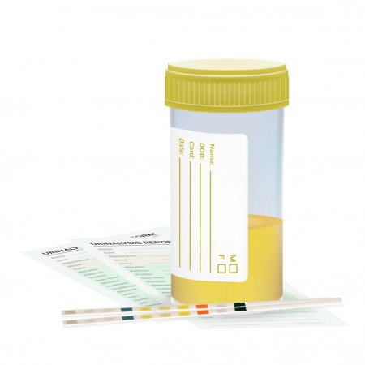
I intensive care
C creatinine
U urine output
P Predictor

Slide 2
question
Can we come up with better urine output and serum creatinine criteria and stages for acute kidney injury in the ICU based on clinical outcomes?

Slide 3
Why does this matter
The different stages (cut off values) of KDIGO are based solely on expert opinion

Slide 4
Mimic data base
Patients admitted to ICU (age 18-90)
50,091
Exclusions:
Not first ICU admission 13,682
Elixhauser Renal Failure 4,487
ICU <4hrs 105
< 2 data points for each metric 32
Dialysis before ICU admit 60
31,723

Slide 5
Factor | All | No HD /death | HD or Death | p-value
N | 31723 | 28179 | 3544
Age, in years, mean (SD) | 61.6 (16.9575) | 60.9 (16.9791) | 66.6 (15.9072) | <0.001
Sex, male, n (%) | 18130 (57.2%) | 16244 (57.6%) | 1886 (53.2%) | <0.001
Ethnicity, n(%) |  |  |  | <0.001
Asian | 753 (2.4%) | 660 (2.3%) | 93 (2.6%)
Black | 2182 (6.9%) | 1978 (7%) | 204 (5.8%)
Hispanic | 1065 (3.4%) | 988 (3.5%) | 77 (2.2%)
White | 22,523 (71%) | 20,165 (71.6%) | 2358 (66.5%)
Other | 5200 (16/4%) | 4388 (15.6%) | 812 (22.9%)
Height, in cm, median (IQR) | 170.2 (162.56, 177.8) | 170.2 (162.56, 177.8) | 168 (160.02, 177.8) | <0.001
Weight, in kg, median (IQR) | 79 (66.5, 93) | 79.5 (67, 93.3) | 75 (62.7, 90) | <0.001
BMI, median (IQR) | 27.44 (23.99, 31.7) | 27.49 (24.1, 31.74) | 26.91 (23.04, 31.53) | <0.001
APACHE Physiologic Score III, mean (SD) | 38.7557 (18.4473) | 36.0116 (15.09) | 60.5751 (26.4533) | <0.001
SOFA, median (IQR) | 3 (1, 5) | 3 (1, 5) | 6 (4, 10) | <0.001
Hospital length of Stay, in days, median (IQR) | 7 (4, 12) | 7 (4, 11) | 7 (2, 16) | 0.024
ICU length of stay, in days, median (IQR) | 2 (1, 4) | 2 (1, 4) | 4 (2, 9) | <0.001
Dialysis Ever, n (%) | 660 (2.1%) |  | 660 (18.6%)

Slide 6
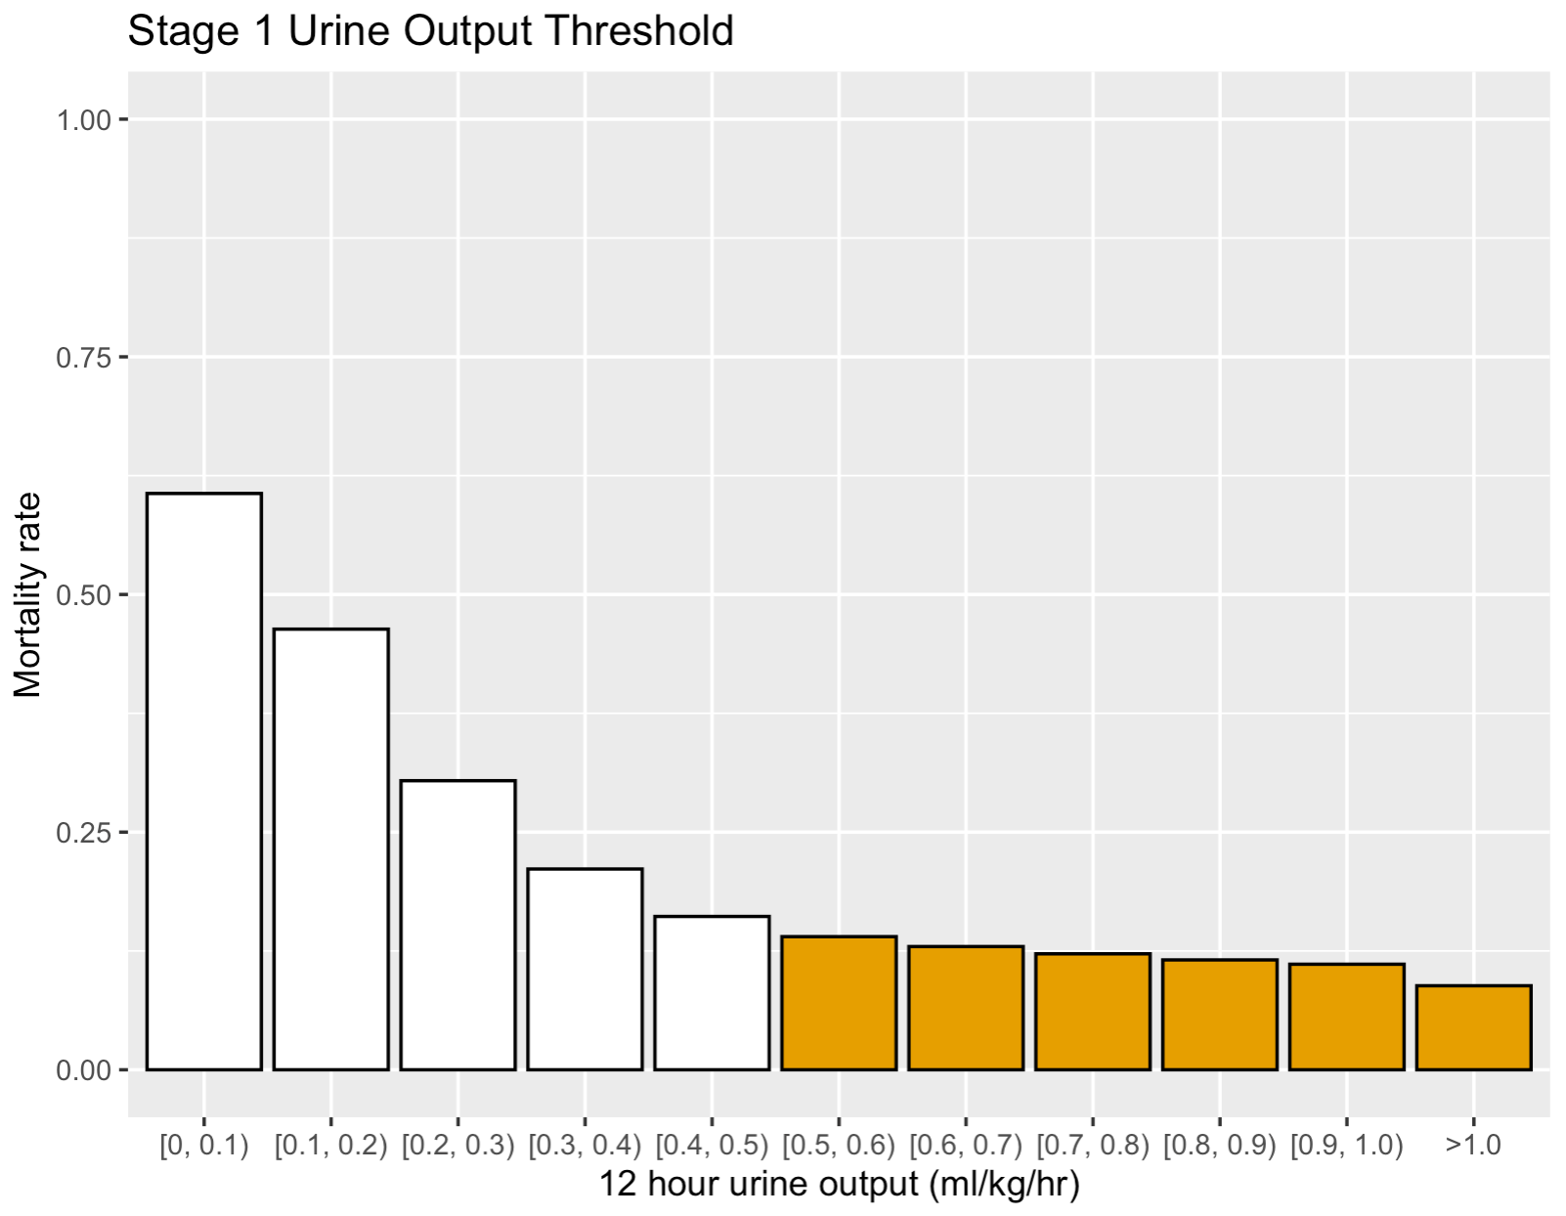
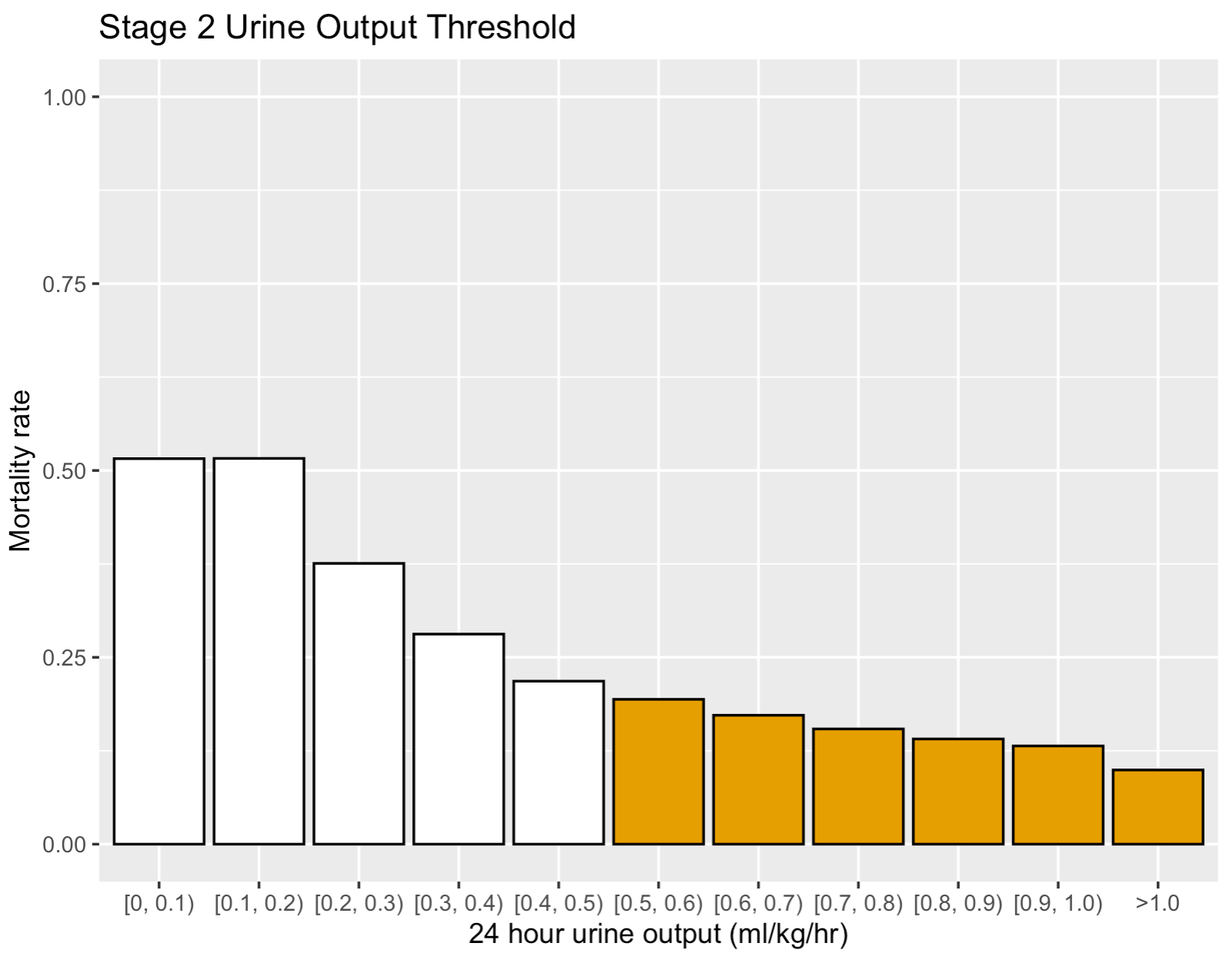
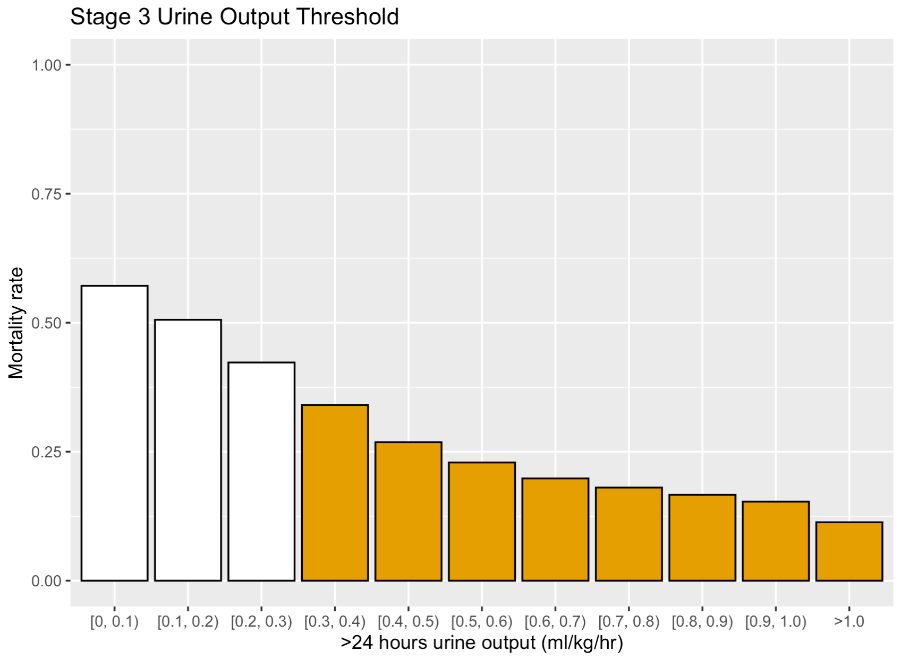
KDIGO AUC .6

Slide 7
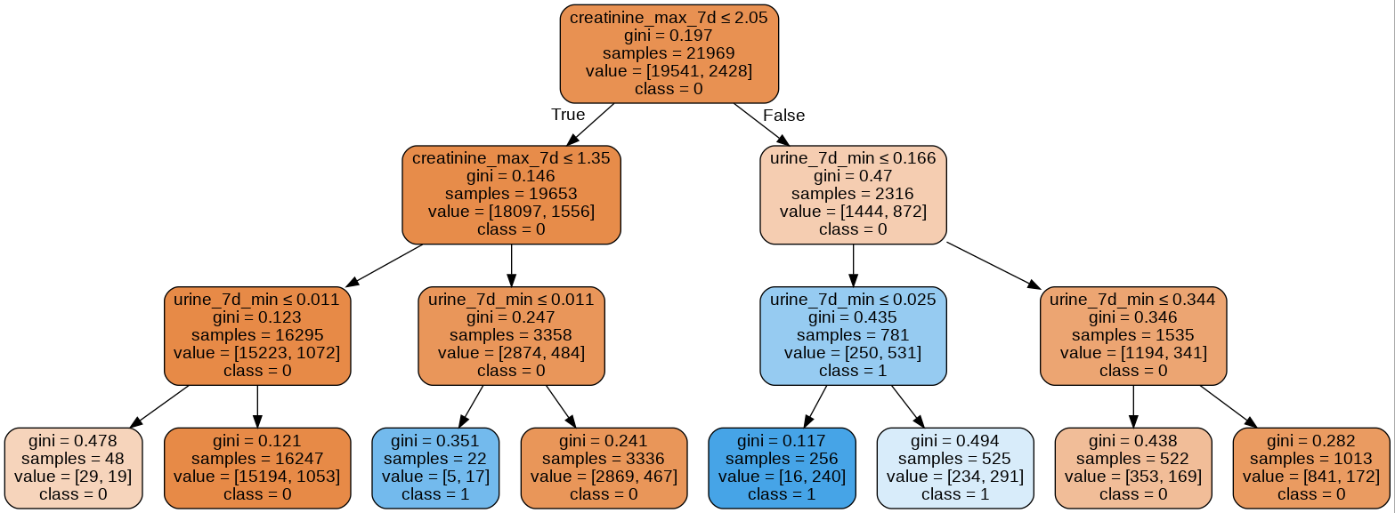
Dialysis/Mortality First 7 Days
ICUP AUC .69
 | Stage 0 | Stage 1 | Stage 2 | Stage 3
Dialysis or Death | 6.6% | 14.4% | 22.2% | 68.0%
Maximum Cr in 7 day | =<1.35 | > 1.35 and <= 2.05 | > 2.05 | > 2.05
Minimum urine output over 24 hours in 7 days | N/A | NA | > 0.166 ml/kg/hr | <= 0.166 ml/kg/hr

Slide 8
ICUP staging for risk of HD or Death
 | Stage 0 | Stage 1 | Stage 2 | Stage 3
Dialysis or Death | 6.6% | 14.4% | 22.2% | 68.0%
Maximum Cr in 7 day | =<1.35 | > 1.35 and <= 2.05 | > 2.05 | > 2.05
Minimum urine output over 24 hours in 7 days | N/A | NA | > 0.166 ml/kg/hr | <= 0.166 ml/kg/hr

Slide 9
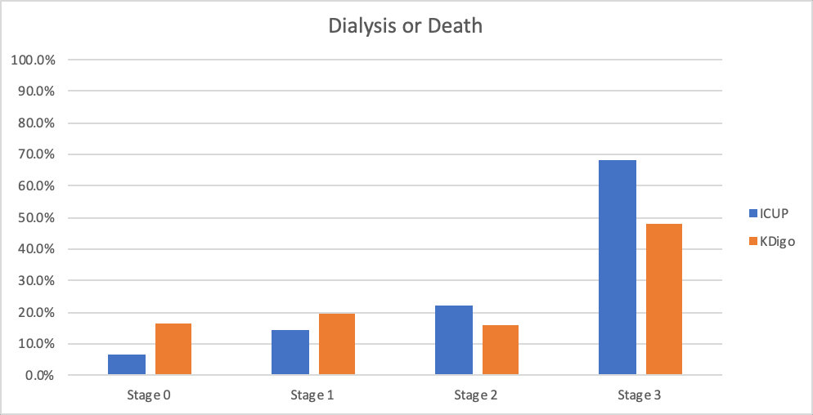
KDIGO AUC .6
ICUP AUC .69

Slide 10
Conclusions
Able to predict Dialysis or Mortality with higher accuracy (KDIGO AUC .6, ICUP AUC .69)
Easy to implement no baseline value needed
Less data needed to determine out come

Slide 11
Future Directions
Further validation using more than one dataset
More advanced machine learning methods
Prospective validation

Slide 12
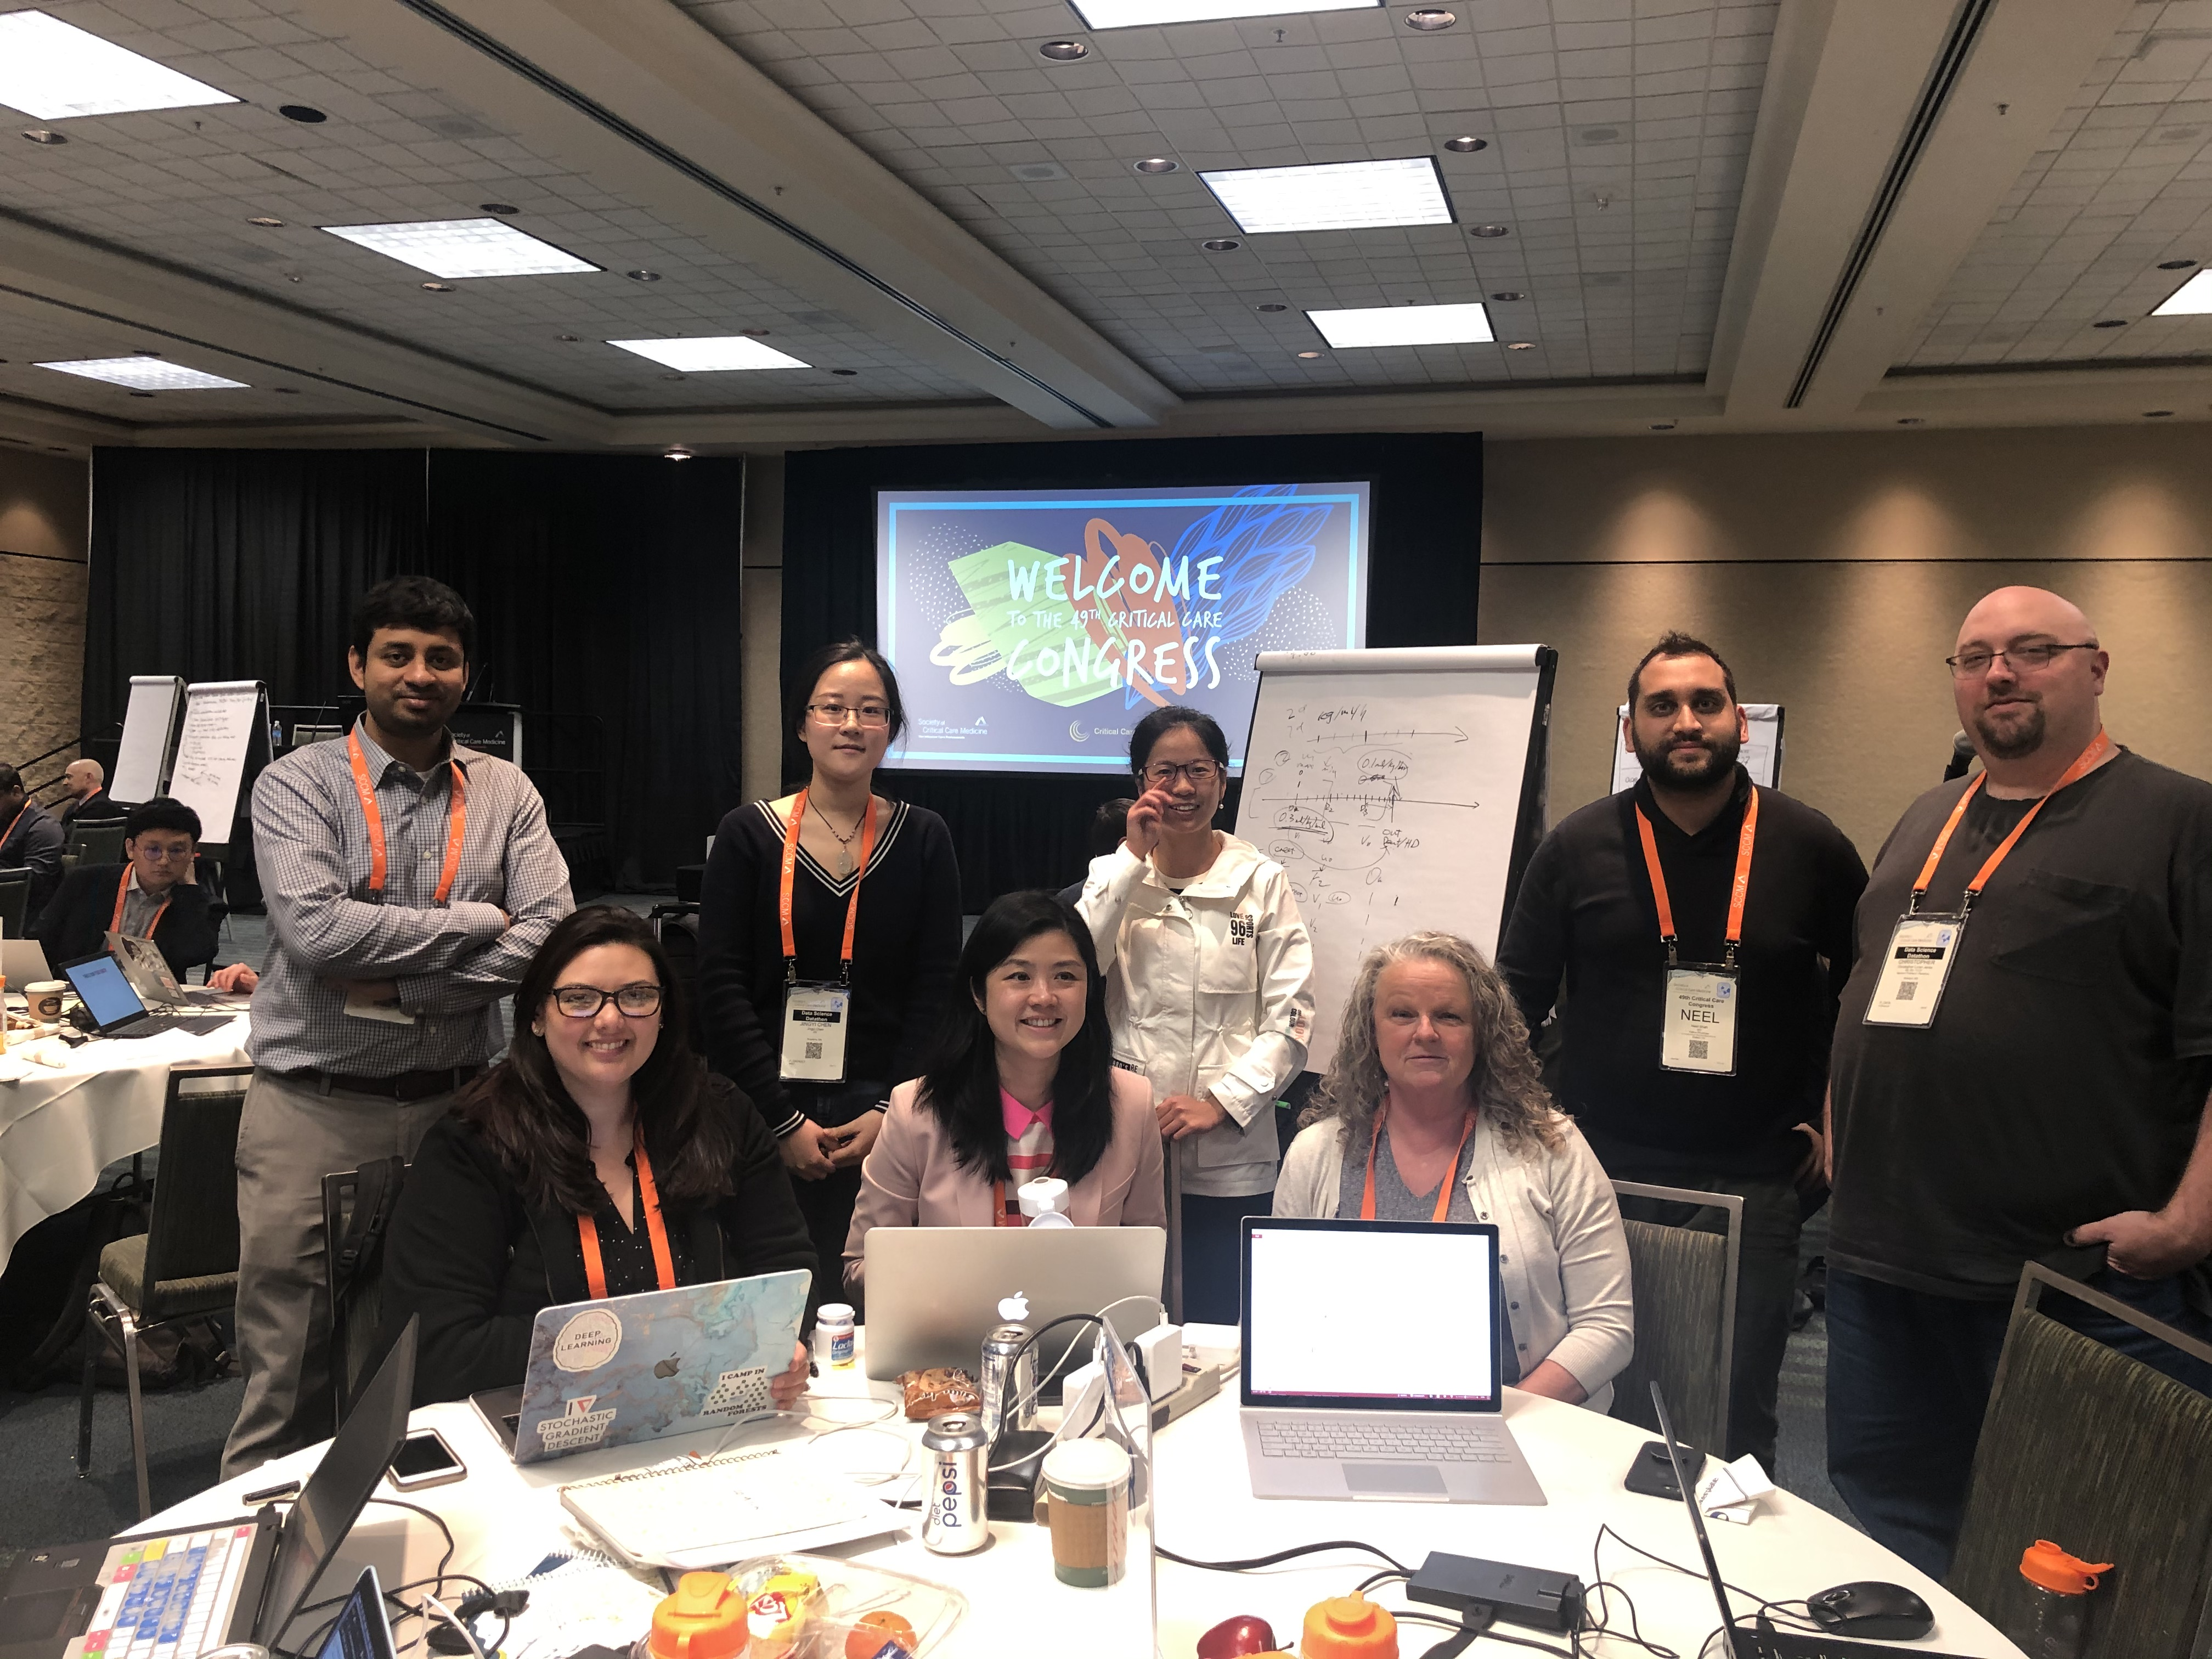

KADIGO Got to Go!!

